Slide 1
University of Gujrat Department of Computer Science
Course Code : CS-252
Computer Organization and Assembly Language
Lecture # 6
Introduction to Assembly Language

Slide 2
Contents
Specific Machine Levels
Assembly Language
Assembly Language relation to machine language
High-Level Language relation to Machine Language
Portability of Assembly Language
Creating and running a Program

Slide 3
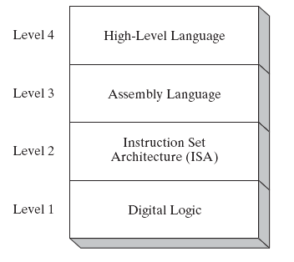
Specific Machine Levels

Slide 4
Assembly Language
Low-Level language
Oldest of all programming Languages
Bears closest resemblance to native machine language
Provides direct access to computer hardware requiring you to understand much about your computer’s architecture and operating system
You need to develop an understanding how memory addresses and instructions work at a low level, if you plan to be High-Level language developer

Slide 5
Assembly Language relation to Machine Language
Machine Language is a numeric language specifically understood by a computer’s processor
Assembly language consists of statements written with short mnemonics such as ADD, SUB and CALL
Assembly language has one-to-one relation with machine language
i.e. One Assembly Language Instruction corresponds to exactly one machine language instruction
Assembly Language
MOV AX,5
Machine Language
10100000 01010000

Slide 6
High-Level Language relation to Machine Language
High-Level Language have one-to-many relationship with assembly language and machine language
e.g.
Assembly Language
mov ax,y
add ax,4
mov bx,3
imul bx
mov x,ax
High Level Language
x = (Y + 4) * 3;

Slide 7
Is Assembly Language Portable?
Assembly language program is not portable because it is designed for specific processor family.
The instructions in assembly language may directly match the computer architecture or they may be translated during execution by a program inside the processor known as microcode interpreter

Slide 8
Creating and Running a Program
Editor
.ASM
File
Assembler
.OBJ
File
Linker
.EXE
File

Slide 9
Programs Required
Assembler
A utility program that converts source code program from assembly language into machine language
Linker
A utility program that combines individual files created by an assembler into a single executable program
Debugger
A utility program that lets you to step through a program while its running and examine registers and Memory

Slide 10
A Simple Program
Move 5 to AX
Move 10 to BX
ADD BX to AX
Move 15 to BX
ADD BX to AX
Assembly Language
mov ax,5
mov bx,10
add ax,bx
mov bx,15
add ax,bx

Slide 11
General Instruction Format
instruction dest, src
instruction dest
instruction src
instruction

Slide 12
EX01.ASM
[ORG 100h]
mov ax,5
mov bx,10
add ax,bx
mov bx,15
add ax,bx
mov ax,4C00h
int 21h

Slide 13
Word Representation
2 Byte Word
Representation in Memory
MSB
LSB
Representation 1
Big Endian Notation
MSB
LSB
0 1
Representation 2
Little Endian Notation
LSB
MSB
0 1

